Slide 1

Voice over IP
By
Sainath Kondapally
Vishwanath Akuthota

Slide 2

Voice Over IP (VOIP)
VoIP is a technology that allows you to make calls over internet using transmission or voice protocol and share multimedia, which is unlike to that of a traditional telephone service.
Alternate terms: Internet Telephony, IP telephony, Internet calling

Slide 3

How it works ?
Continuously sample audio
Convert each sample to digital form
Send digitized stream across Internet in packets
Convert the stream back to analog for playback
VOIP phones utilize packet-switched Voice over Internet Protocol (VoIP), or Internet telephony, to transmit telephone calls over the Internet as opposed to the circuit-switched telephony used by the traditional Public Switched Telephone Network (PSTN).

Slide 4
Why VoIP?
IP telephony is economic;
High costs for traditional telephone switching equipments.
Challenges
Call setup: call establishment, call termination, etc.
Voice transmission delay
Backward compatibility with existing PSTN (Public Switched Telephone Network)

Slide 5
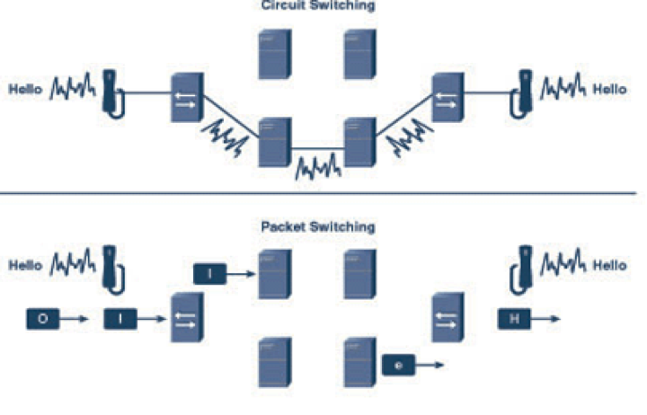
Circuit switching VS Packet switching

Slide 6
Encoding, Transmission, & Playback
Both groups agree on the basics for encoding and transmission of audio:
Audio is encoded using a well-known standard such as Pulse Code Modulation (PCM).
Audio is transferred using the Real-time Transport Protocol (RTP).
RTP message is encapsulated in a UDP datagram that is further encapsulated in an IP datagram for transmission.

Slide 7
Encoding, Transmission, & Playback
•UDP is used for transport because
– lower overhead: audio must be played as it arrives.
– Playback cannot be stopped to wait for a retransmitted packet.
•Two independent RTP sessions exist, because an IP phone call involves transfer in two directions
– IP phone acts as sender for outgoing data, and
– IP phone acts as receiver for incoming data

Slide 8
Signaling Systems & Protocols
•Main complexity of VoIP: Call setup and call management.
•The process of establishing and terminating a call is called Signaling.
–In traditional telephone system, signaling protocol is SS7 (signaling System 7).
–In VoIP, signaling protocols are:
•SIP (Session Initiation Protocol), by IETF
•H.323, by ITU
•Megaco & MGCP, jointly by IETF and IUT.
–VoIP signaling protocols should be able to interact with SS7.

Slide 9
Signaling Protocols
Two major protocols: H.323, SIP
H.323, invented by ITU, defines four elements that comprising a signaling system:
– Terminal: IP phone
– Gatekeeper: provides location and signaling functions; coordinates operation of Gateway.
– Gateway: used to interconnect IP telephone system with PSTN, handling both signaling and media translation.
– Multipoint Control Unit: provides services such as multipoint conferencing.

Slide 10
Signaling Protocols
SIP: Session Initiation Protocol. Invented by IETF.
SIP defines three main elements that comprise a signaling system:
– User Agent: IP phone or applications
– Location servers: stores information about user’s location or IP address
–Support servers:
Proxy Server: forwards requests from user agents to another location.
Redirect Server: provides an alternate called party’s location for the user agent to contact.
Registrar Server: receives user’s registration requests and updates the database that location server consults.

Slide 11
Who uses VoIP?
VoIP is useful in home or personal applications and in business as well. This is because it is considered cheap.
Microsoft is using VoIP for their ‘Xbox’ live service. Enabling customers to be able to talk through a headset to each other. However, they do charge a small fee for the service.
Skype, Viber, Gtalk, Whatsapp, Line and tango, etc,. use VoIP. Skype is used by 20% American businesses.
We can use all these applications on various applications like Windows, Linux, Mac and Android, etc,.

Slide 12

Applications of VoIP:

Slide 13
References
http://www.webopedia.com/TERM/V/VoIP.html
http://www.webopedia.com/TERM/P/PSTN.html
http://www.webopedia.com/TERM/V/voip_phone.html
http://www.webopedia.com/DidYouKnow/Internet/VoIP_POTS_Difference_Between.asp
https://www.fcc.gov/general/voice-over-internet-protocol-voip
https://getvoip.com/blog/2014/01/27/history-of-voip-and-internet-telephones/

